Slide 1
Part 1
Evolution of the mobile graphics world

Slide 2
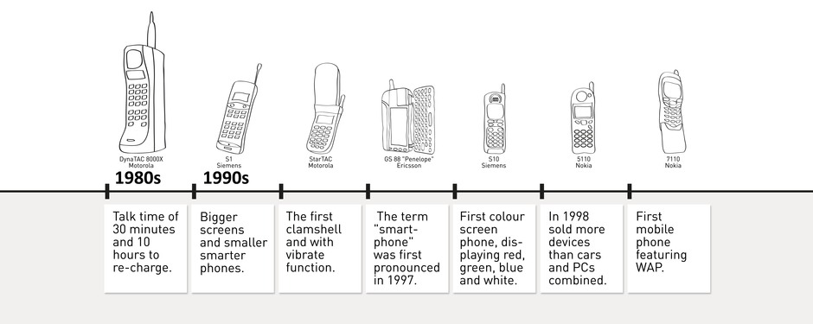
Mobile evolution (1/3)

Slide 3
Mobile evolution (1/3)
Color display

Slide 4
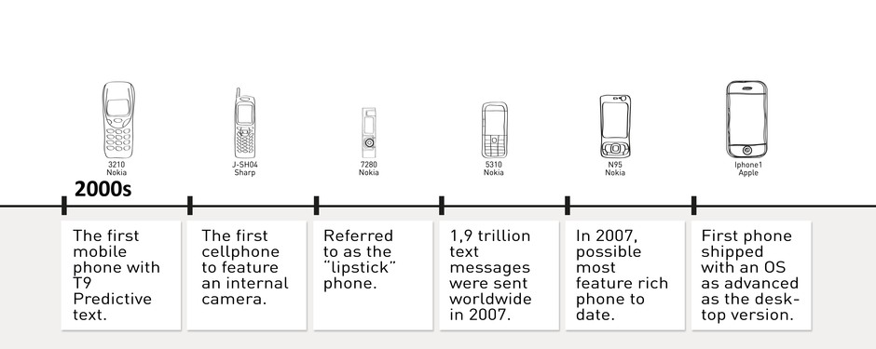
Mobile evolution (2/3)

Slide 5
Mobile evolution (2/3)
Smartphones, OS

Slide 6
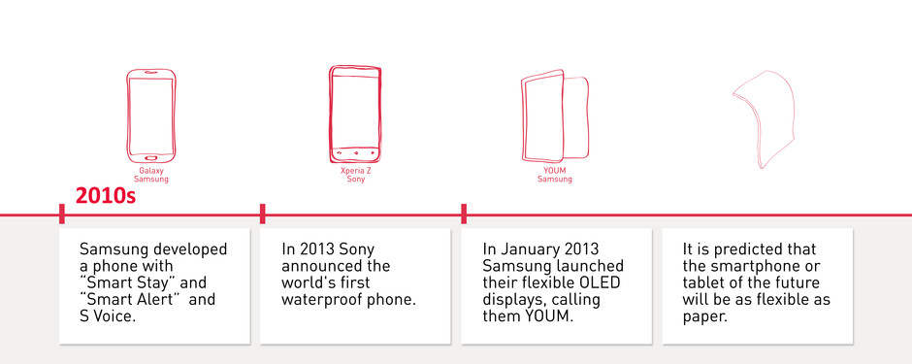
Mobile evolution (3/3)

Slide 7
Mobile evolution (3/3)
High resolution displays

Slide 8
Mobile evolution (3/3)
Similar evolution for PDAs, and tablets

Slide 9
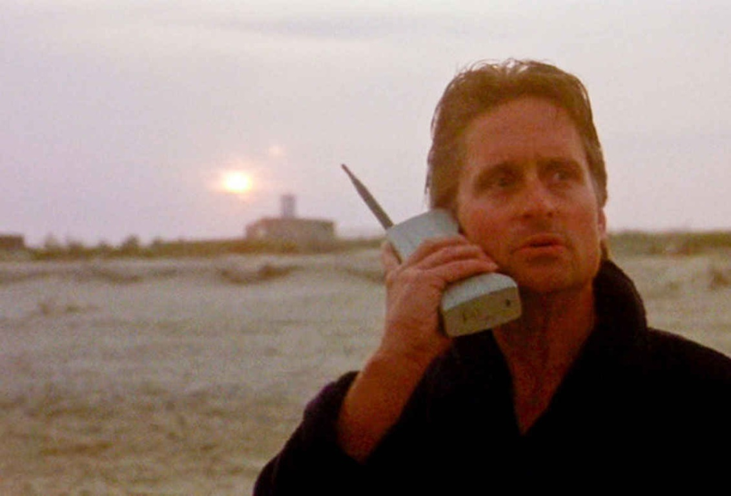
Mobile evolution…. in movies
Money never sleeps…..This is your wake-up call, pal…
GO TO WORK
Motorola DynaTac
Nickname “brick phone”
Weight: over 2 pounds
Cost: thousands of dollars
Battery life: around 35 minutes.
Wall Street, 1987
Michael Douglas in Gordon Gekko

Slide 10
Mobile evolution… in movies
Hello Neo…
Do you know who this is?
Nokia 8110
Nickname “banana phone”
145g, display monochrome, Smart SMS
It costed 1000 eur
The Matrix, 1999
Laurence Fishburne in Morpheus

Slide 11
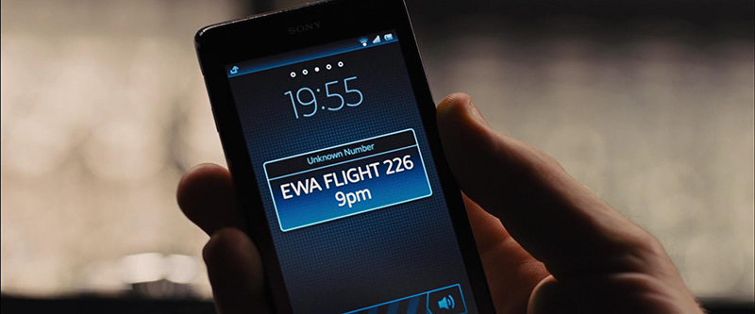
Mobile evolution… in movies
Sony Xperia T
Smartphone Android
Display 4.6” 1280x720
It costed 600 eur
13 Mpixel camera + position sensors
Skyfall, 2012
Daniel Craig in James Bond

Slide 12
Mobile evolution… in movies
Future devices?
Transparent and foldable high resolution screens
Gesture interfaces
Wearable / integrated to body
Iron Man 3, 2013
Robert Downey Jr in Tony Stark

Slide 13
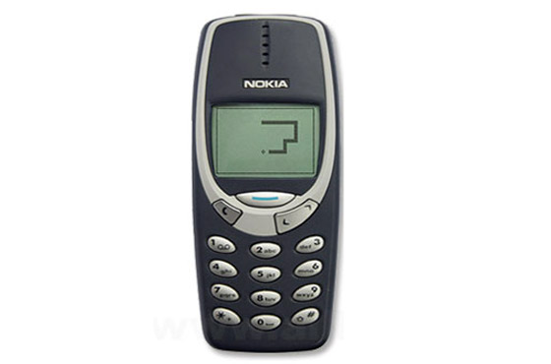
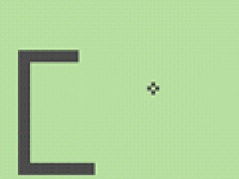
Mobile evolution... in games
Nokia Snakes
From 1997 an estimated 350 Mdevices, making it one of the most widely distributed games ever created.
Installed on Nokia devices until 2007

Slide 14
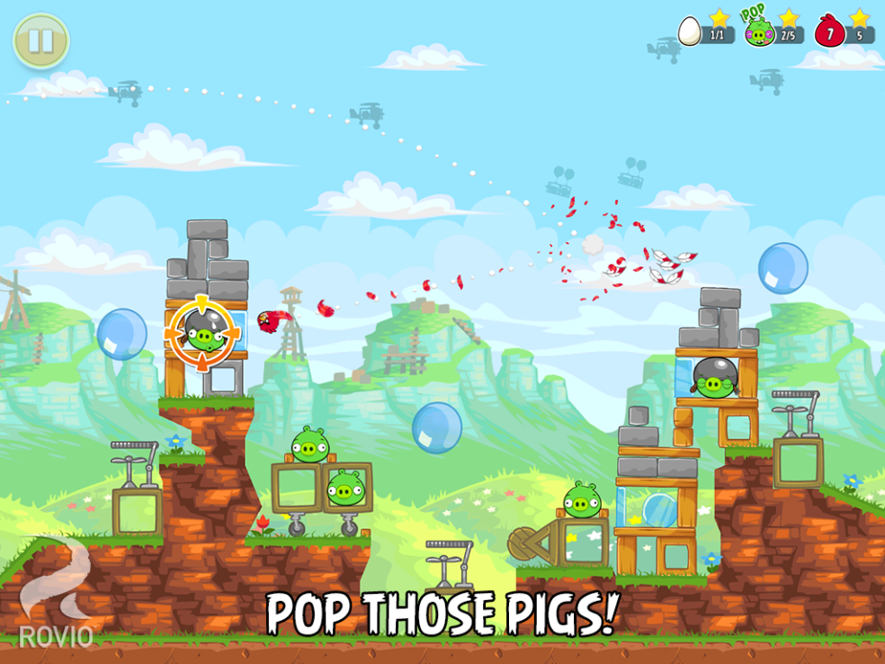
Mobile evolution… in games
Angry Birds (Rovio)
first released for Apple's iOS in December 2009
2 billion downloads across all platforms
widespread diffusion end popolarity
Adventure parks (Finland and Malaysia)

Slide 15
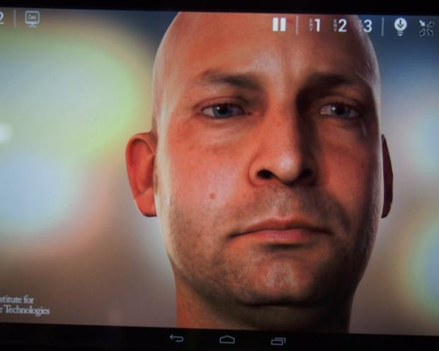
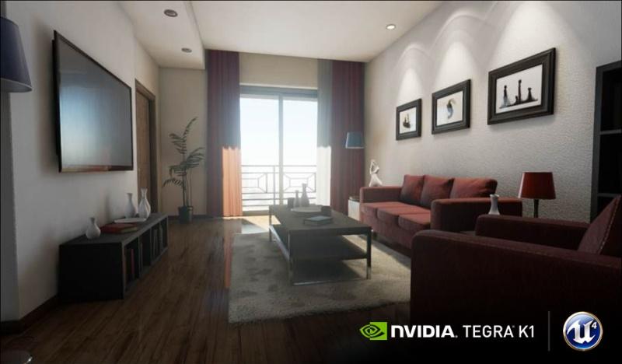
Mobile evolution… in games
Unreal Engine (GDC & Google I/O 2014)
running on an Nvidia Tegra K1 processor
will support Google Tango and Samsung Gear VR
easy porting of games
sophisticated 3d effects

Slide 16
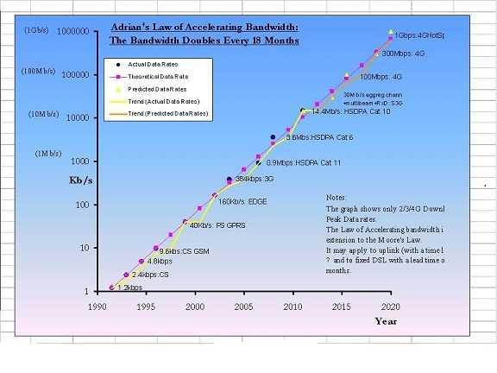
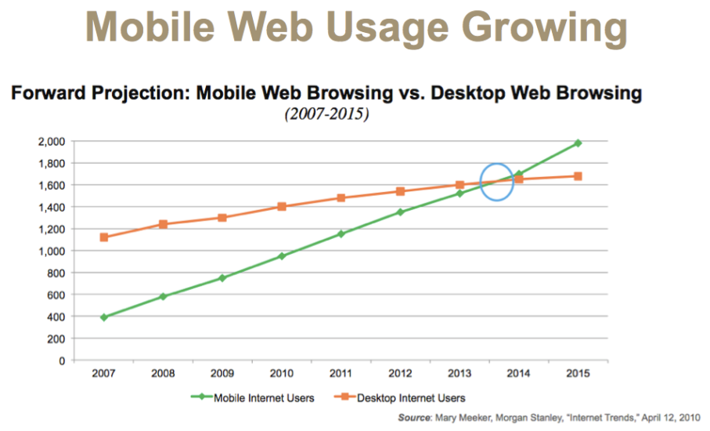
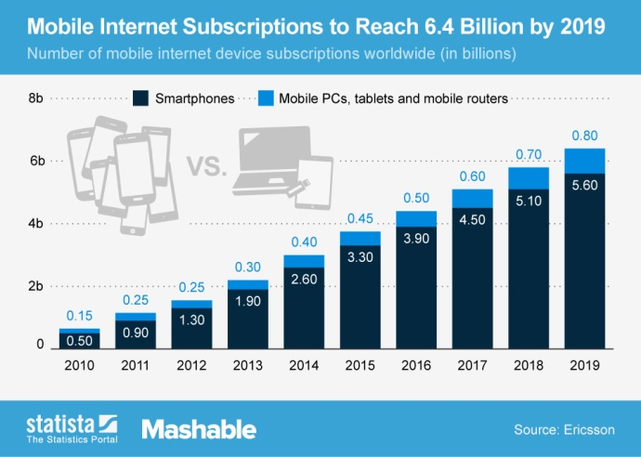
Mobile connectivity evolution
Bandwidth is doubling every 18 months
Mobile internet users overcame desktop internet users
2017 smartphone traffic expected at 2.7 GB per person per month

Slide 17
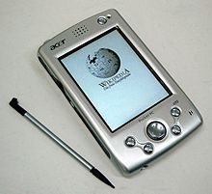
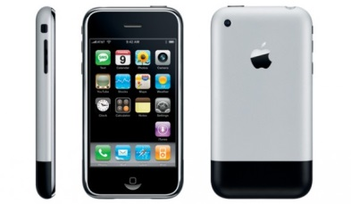
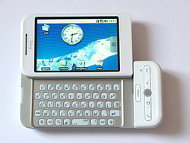
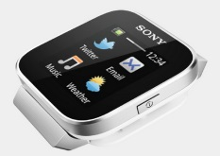
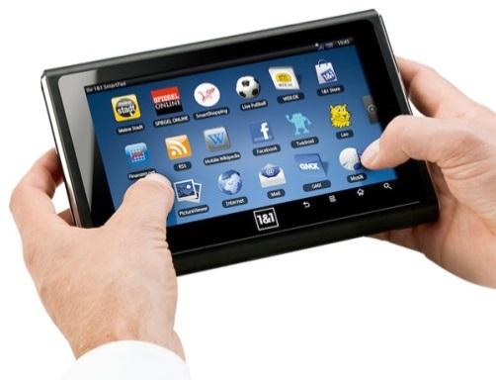
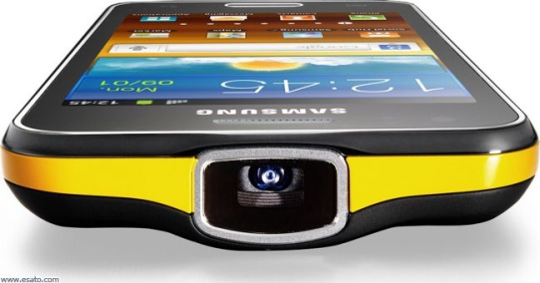
Displays and User Interface
Before 2007 – old days
PDA → Palm OS/ Windows Pocket / Windows CE
Stylus interaction (touch screens at early stages)
Touch era
2007 – iOS /iPhone
2008 – Android / HTC Dream or G1
Touch-enabled devices (no stylus required)
Nowadays
Wearables → <2”
Smartphones → 3-6”
Tablets → >7-10”
DLP projectors integrated

Slide 18
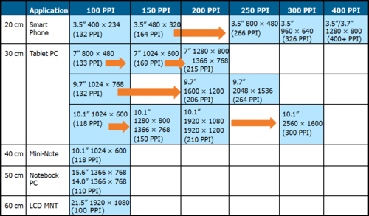
Display characteristics
500 ppi
5.1”/5.5” 2560x1440 (>500 PPI)
10.1”
3840x2160
(438 PPI)

Slide 19
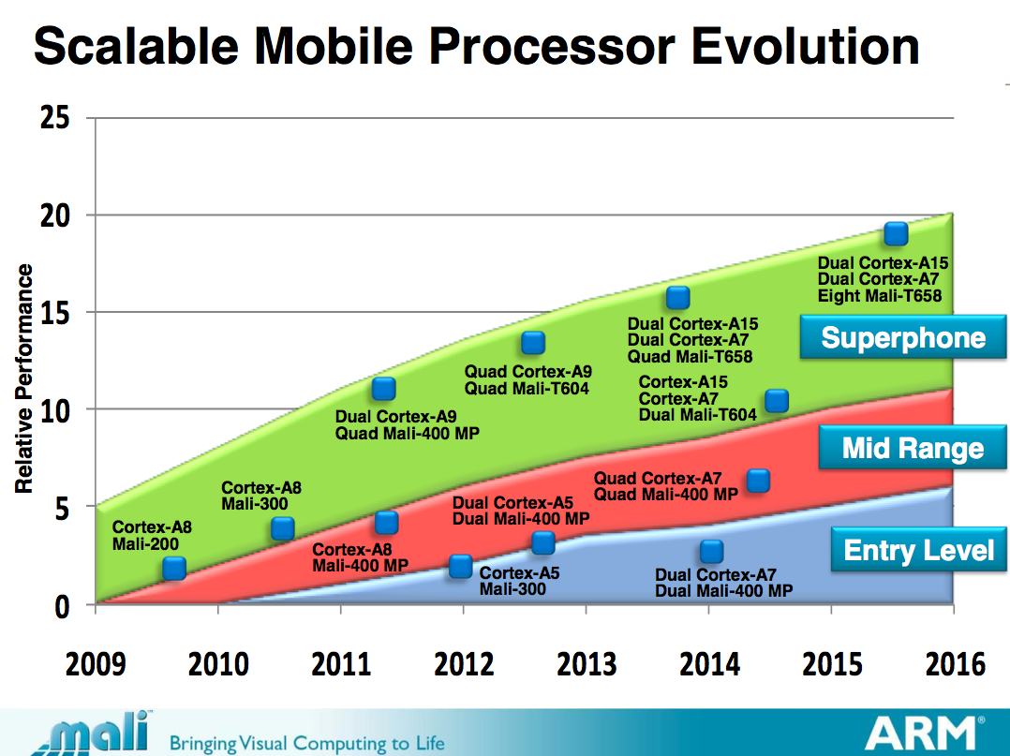
Chip evolution (1/2)

Slide 20
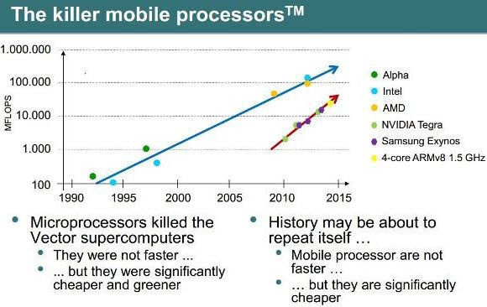
Chip evolution (2/2)

Slide 21
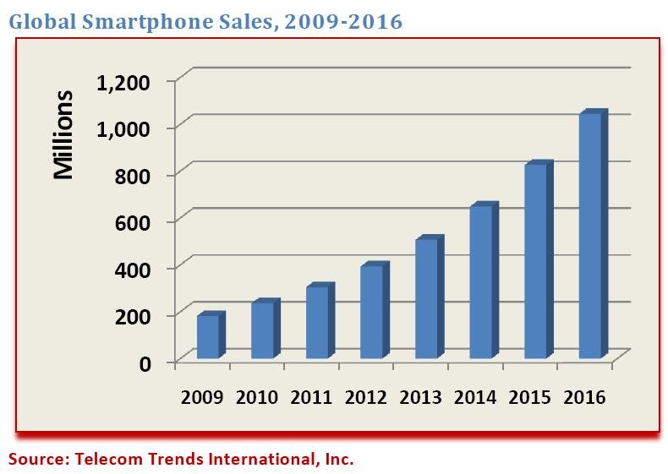
Scenario
Modern smartphones (tablets) are compact visual computing powerhouses
DIFFUSION: more than 4.6 billion mobile phone subscriptions
[Ellison 2010]
NETWORKING: High speed internet connection (typical 1GB/month plan)
3G - < 0.6-3Mbps ~ 100KB/s - 400KB/s (latency ~ 100-125ms)
4G – < 3-10Mbps ~ 400KB/s - 1MB/s (latency ~ 60-70ms)
5G - 1Gbps (from 2016?)
MEMORY: Increasing RAM and storage space
RAM 1-3GB
Storage 8-64GB
COMPUTING: Increasing processing power
CPU 4-8 core @ 2.5Ghz
GPU 72-192 cores (~ALUs)

Slide 22
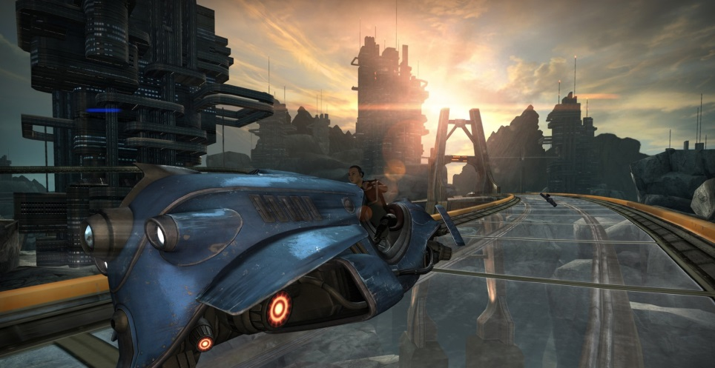
Scenario
More than 4.6 billion mobile phone subscriptions
[Ellison 2010]
High speed internet connection (typical 1GB/month plan)
3G - < 0.6-3Mbps ~ 100KB/s - 400KB/s
4G – < 3-10Mbps ~ 400KB/s - 1MB/s
Increasing RAM and storage space
RAM 1-3GB
Storage 8-64GB
Increasing processing power
CPU 4-8 core @ 2.5Ghz
GPU 72-192 cores (~ALUs)
http://unity3d.com/es/unity/multiplatform/mobile

Slide 23
Where are we going?
Powerful devices for acquiring, processing and visualizing information
Accessibility of information (anybody, any time, anywhere)
Immense potential (integration of acquisition, processing, visualization, cloud computing, and collaborative tasks)

Slide 24
MOBILE GRAPHICS TRENDS: HARDWARE ARCHITECTURES & APPLICATIONS
Next Session

